Slide 1
CIS 9660 – Data Mining for Analytics
Week 6 Neural Networks
Prof. Arturo Castellanos
CIS Department Office: VC11-229

Slide 2
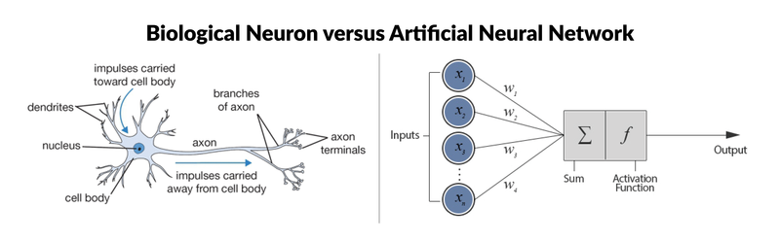

Perceptrons
The most simple neural network is the “perceptron”, which, in its simplest form, consists of a single neuron. The single artificial neuron is a simple tree structure which has input nodes and a single output node, which is connected to each input node.
This result will be the input for a transfer or activation function. just like a biological neuron only fires when a certain threshold is exceeded, the artificial neuron will also only fire when the sum of the inputs exceeds a threshold
Source: https://www.datacamp.com/community/tutorials/deep-learning-python

Slide 3
Network Structure
Multiple layers
Input layer (raw observations)
Hidden layers
Output layer
Nodes
Weights (like coefficients, subject to iterative adjustment)
Bias values (also like coefficients, but not subject to iterative adjustment)

Slide 4
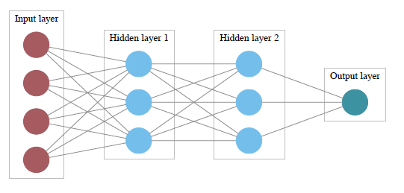
Schematic Diagram

Slide 5
General Structure of ANN
Training ANN means learning the weights of the neurons

Slide 6
Tiny Example
Predict consumer opinion of cheese product based on fat and salt content
Obs. Fat Score Salt Score Opinion
1 0.2 0.9 like
2 0.1 0.1 dislike
3 0.2 0.4 dislike
4 0.2 0.5 dislike
5 0.4 0.5 like
6 0.3 0.8 like
1

Slide 7
The Input Layer
For input layer, input = output
E.g., for record #1:
Fat input = output = 0.2
Salt input = output = 0.9
Output of input layer = input into hidden layer

Slide 8
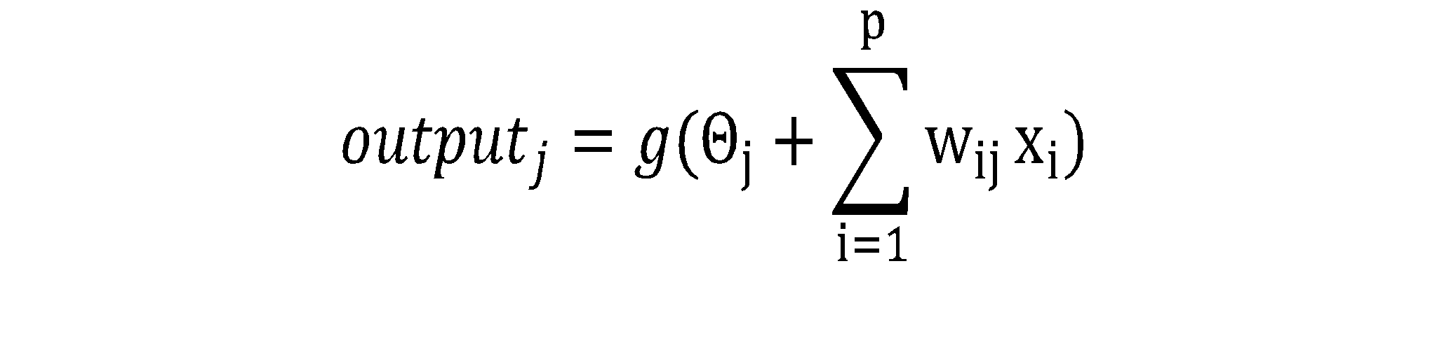
The Hidden Layer
In this example, it has 3 nodes
Each node receives as input the output of all input nodes
Output of each hidden node is some function of the weighted sum of inputs

Slide 9
The Weights
The weights θ (theta) and w are typically initialized to random values in the range -0.05 to +0.05
Equivalent to a model with random prediction (in other words, no predictive value)
These initial weights are used in the first round of training

Slide 10
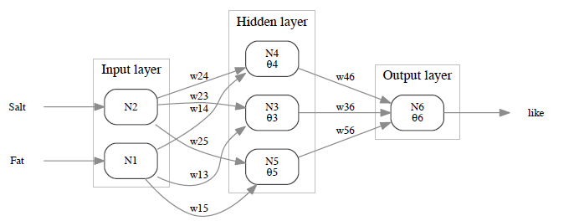
Example – Using fat & salt content to predict consumer acceptance of cheese
Rectangles are nodes, w_{ij} on arrows are weights, and ϴ_{j} are node bias values

Slide 11
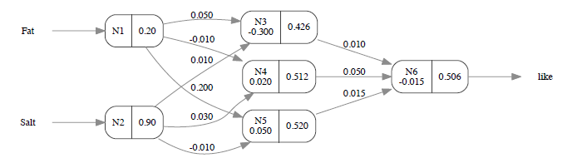

Initial Pass of the Network
Node outputs (on right within node) using first record in tiny example, and logistic function
Calculations at hidden node 3 (if g is a logistic function):

Slide 12

Output Layer
The output of the last hidden layer becomes input for the output layer

Slide 13
Mapping the output to a classification
Output = 0.506, just slightly in excess of 0.5, so classification, at this early stage, is “like”

Slide 14

Relation to Linear Regression
A net with a single output node and no hidden layers, where g is the identity function, takes the same form as a linear regression model

Slide 15
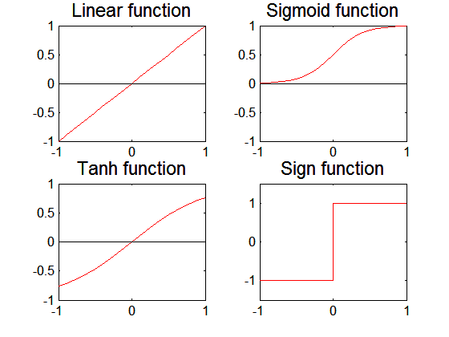
Artificial Neural Networks (ANN)
Various types of neural network topology
single-layered network (perceptron) versus multi-layered network
Feed-forward versus recurrent network
Various types of activation functions (f)

Slide 16
Python Packages for Neural Nets
Most common for basic neural nets:
scikit-learn
For deep learning:
tensorflow
keras
pytorch

Slide 17
Import Functionality Needed
import pandas as pd
from sklearn.model_selection import train_test_split
from sklearn.neural_network import MLPClassifier
from dmba import classificationSummary

Slide 18
Code for Tiny Example
Using MPClassifier in scikit-learn
clf = MLPClassifier(hidden_layer_sizes=(3), activation='logistic',
solver='lbfgs', random_state=1)
clf.fit(X, y)
clf.predict(X)

Slide 19
# Look at network structure
print('Intercepts')
print(clf.intercepts_)
print('Weights')
print(clf.coefs_)
Intercepts
[array([0.13368045, 4.07247552, 7.00768104]),
array([14.30748676])]
Weights
[array([
[ -1.30656481, -4.20427792, -13.29587332],
[ -0.04399727, -4.91606924, -6.03356987]
]),
array([
[ -0.27348313],
[ -9.01211573],
[-17.63504694]
])]

Slide 20
Predictions
# Prediction
print(pd.concat([
example_df,
pd.DataFrame(clf.predict_proba(X), columns=classes)
], axis=1))
Fat Salt Acceptance dislike like
0 0.2 0.9 like 0.000490 0.999510
1 0.1 0.1 dislike 0.999994 0.000006
2 0.2 0.4 dislike 0.999741 0.000259
3 0.2 0.5 dislike 0.997368 0.002632
4 0.4 0.5 like 0.002133 0.997867
5 0.3 0.8 like 0.000075 0.999925

Slide 21
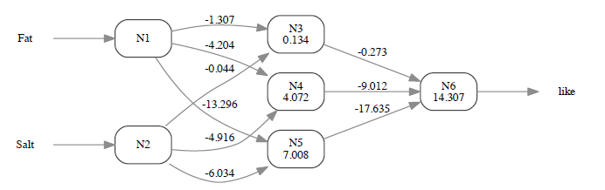
Tiny Example - Final Weights

Slide 22
Common Criteria to Stop the Updating
When weights change very little from one iteration to the next
When the misclassification rate reaches a required threshold
When a limit on runs is reached

Slide 23
Avoiding Overfitting
With sufficient iterations, neural net can easily overfit the data
To avoid overfitting:
Track error in validation data or via cross-validation
Limit iterations
Limit complexity of network

Slide 24
User Inputs

Slide 25
Specify Network Architecture
Number of hidden layers
Most popular –use argument hidden_layer_sizes)
Number of nodes in hidden layer(s)
More nodes capture complexity, but increase chances of overfit (use argument hidden_layer_sizes)
Number of output nodes
For classification with m classes, use m or m-1 nodes
For numerical prediction use one

Slide 26
Network Architecture, cont.
“Learning Rate” (argument learning_rate)
Low values “downweight” the new information from errors at each iteration
This slows learning, but reduces tendency to overfit to local structure

Slide 27
Advantages
Good predictive ability
Can capture complex relationships
No need to specify a model

Slide 28
Disadvantages
Considered a “black box” prediction machine, with no insight into relationships between predictors and outcome
No variable-selection mechanism, so you have to exercise care in selecting variables
Heavy computational requirements if there are many variables (additional variables dramatically increase the number of weights to calculate)

Slide 29
Deep Learning
The statistical and machine learning models in this book - including standard neural nets - work where you have informative predictors (purchase information, bank account information, # of rooms in a house, etc.)
In rapidly-growing applications of voice and image recognition, you have high numbers of “low-level” granular predictors - pixel values, wave amplitudes, uninformative at this low level

Slide 30
Multilayer Neural Network
Hidden layers
intermediary layers between input & output layers
More general activation functions (sigmoid, linear, etc)
Approximate error in hidden nodes by error in the output nodes
Problem:
Not clear how adjustment in the hidden nodes affect overall error
No guarantee of convergence to optimal solution

Slide 31
Characteristics of ANN
Multilayer ANN are universal approximators but could suffer from overfitting if the network is too large
Gradient descent may converge to local minimum
Model building can be very time consuming, but testing can be very fast
Can handle redundant attributes because weights are automatically learnt
Sensitive to noise in training data
Difficult to handle missing attributes

Slide 32
Deep learning (1)
Deep learning allows computational models that are composed of multiple processing layers to learn representations of data with multiple levels of abstraction.
Speech recognition
Visual object recognition (object detection)
Drug discovery
Genomics
Deep learning discovers intricate structure by using backpropagation to change parameters used to compute the representation in each layer from the representation in the previous layer.

Slide 33
Deep learning (2)
Convolutional neural networks (ConvNets): useful to process data that come in the form of multiple arrays. Used for detection, segmentation, and recognition of objects and regions in images
Applications: face recognition, traffic sign recognition
Recurrent Neural Nets (RNNs): for tasks that involve sequential inputs (e.g., speech, language). RNNs process an input sequence one element at a time.
Applications: next character in the text, next workd in a sequence

Slide 34
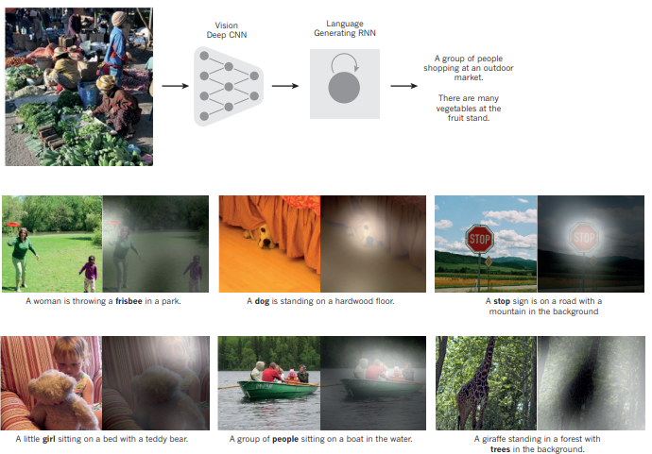
Deep learning (3)
ConvNets + RNNs application: image captioning

Slide 35
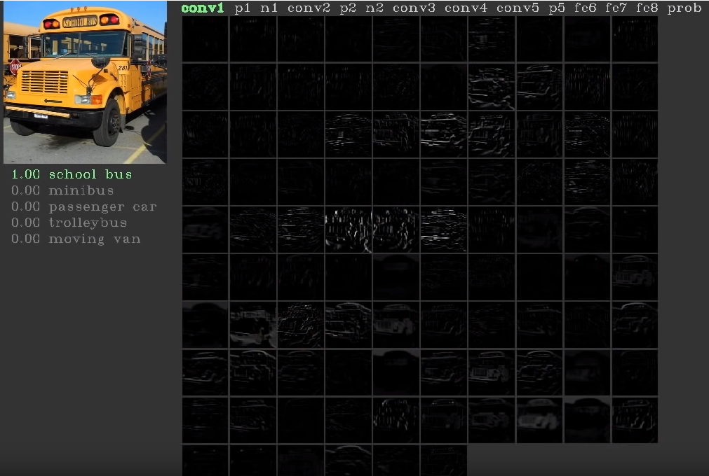
Short video (Deepvis)

Slide 36
Recent Noteworthy Developments in ANN
Use in deep learning and unsupervised feature learning
Seek to automatically learn a good representation of the input from unlabeled data
Google Brain project
Learned the concept of a ‘cat’ by looking at unlabeled pictures from YouTube
One billion connection network

Slide 37
Parameters of Neural Nets (Application)
Epochs: Number of times the whole data set is passed through the network
Updater: Method used to calculate new weight and bias values in order to minimize the chosen loss.
SGD: Stochastic gradient descent. Uses a learning rate to adjust the extend to which weights and biases are updated.
Adam: Adaptive momentum change. http://arxiv.org/abs/1412.6980
Weight initialization: The process of finding the best weight values during training is an iterative process and requires start values.
Bias: While the weights are multiplied to input data, the bias values are added ontop of this product.
Activation: The activation function (non-linearity) to be used by the neurons in the hidden layers.
Hidden layer sizes: The number and size of each hidden layer in the model. For example, if a user specifies "100,200,100" a model with 3 hidden layers will be produced, and the middle hidden layer will have 200 neurons.
Notes:
We introduce Adam, an algorithm for first-order gradient-based optimization of stochastic objective functions, based on adaptive estimates of lower-order moments. The method is straightforward to implement, is computationally efficient, has little memory requirements, is invariant to diagonal rescaling of the gradients, and is well suited for problems that are large in terms of data and/or parameters. The method is also appropriate for non-stationary objectives and problems with very noisy and/or sparse gradients. The hyper-parameters have intuitive interpretations and typically require little tuning. Some connections to related algorithms, on which Adam was inspired, are discussed. We also analyze the theoretical convergence properties of the algorithm and provide a regret bound on the convergence rate that is comparable to the best known results under the online convex optimization framework. Empirical results demonstrate that Adam works well in practice and compares favorably to other stochastic optimization methods. Finally, we discuss AdaMax, a variant of Adam based on the infinity norm.

